Slide 1





https://papers.ssrn.com/sol3/papers.cfm?abstract_id=3817410.

Slide 2
Simmel (1902; Krackhart, 1999):
A dyad remains a private relation; the triad introduces “sociality”: each third person can watch the other two and thereby have the advantage of the tertius gaudens (“the third who benefits”); that is, the third person may see options in the relations between the other two which s/he can use to her advantage.
If the third person actively participates in breaking the tie between the other two, one can consider this as an instance of divide et impera (“divide and rule”).

Slide 3
Supply
Patents
Demand
Infrastructure
Notes:
3

Slide 4
Novelty production
Innovation
Knowledge Infrastructure
Patents
Knowledge-Based Economy
Wealth generation
Legislation/ Regulation
Political Economy
Notes:
4

Slide 5
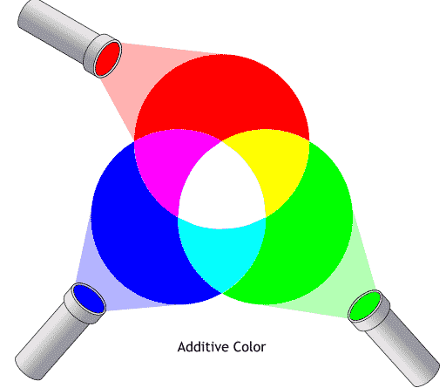
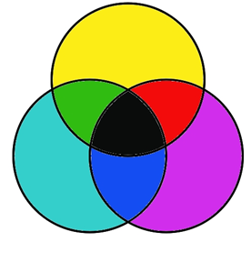
Information / Communication
Transfer (e.g. patents);
Feedbacks;
interacting variations
Trajectories
Sharing of meanings
→ Specification of new options;
Feedforwards;
interacting selection envrionmens
Regimes

Slide 6
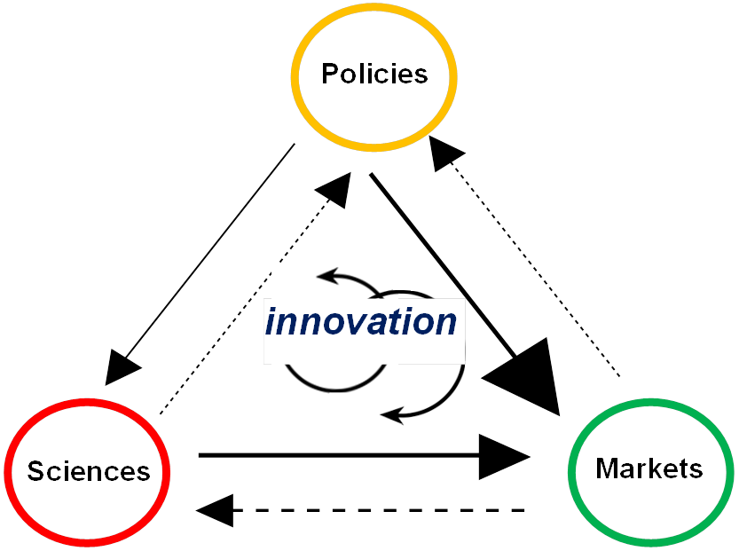
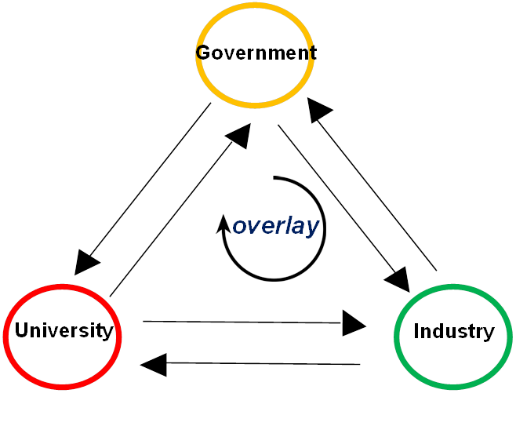
TH network model
(institutional; focus on entrepreneurship)
Neo-evolutionary
TH model
Synergy among functions
→ historical generation of entropy
→ generates redundancy

Slide 7
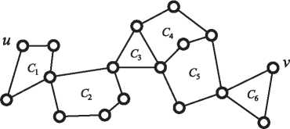

Slide 9
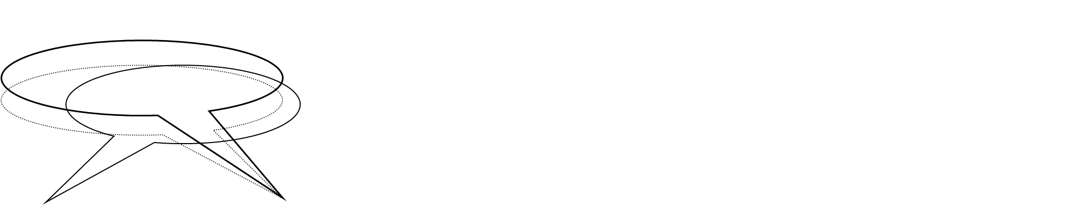

Slide 10


y = ax – bx + c x² − dx³ + …. x_{t})

Slide 11
