Slide 1

Quadruple Helix Collaborations in Practice
dr. Eugen Octav Popa
Post-doc Researcher Responsible Innovation
Wageningen University and Research
eugen.popa@wur.nl

Slide 2

Speaker
Eugen Octav Popa
Post-doctoral Researcher Responsible Innovation, focus on industry R&D (WUR)
Background in Argumentation Theory and Science and Technology Studies
RRI Tools, RiConfigure, RRIStart
E-mail: eugen.popa@wur.nl
LinkedIn, ResearchGate

Slide 3
Agenda for today
Review the concept of QHC
The QHC praxis as we encountered it
Lessons learned
Outstanding questions

Slide 4
Agenda for today
The concept of QHC
The QHC praxis
Lessons learned
Outstanding questions

Slide 5
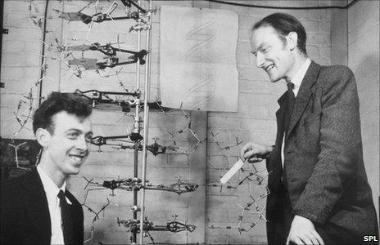
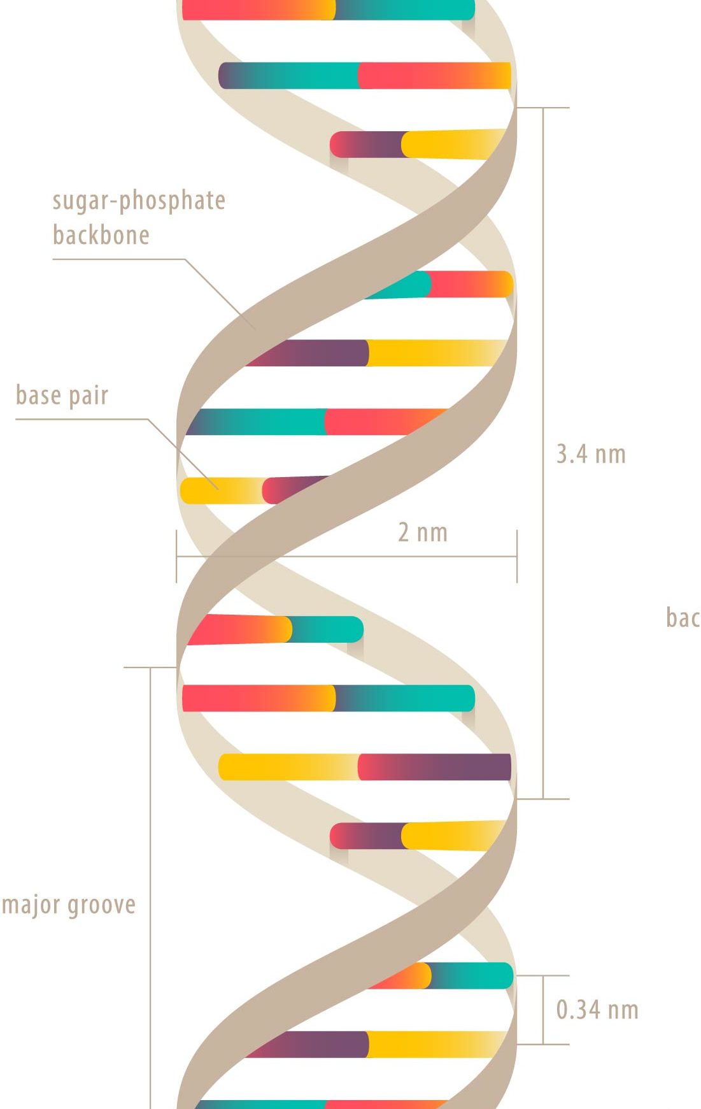
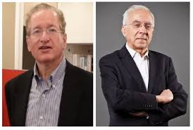
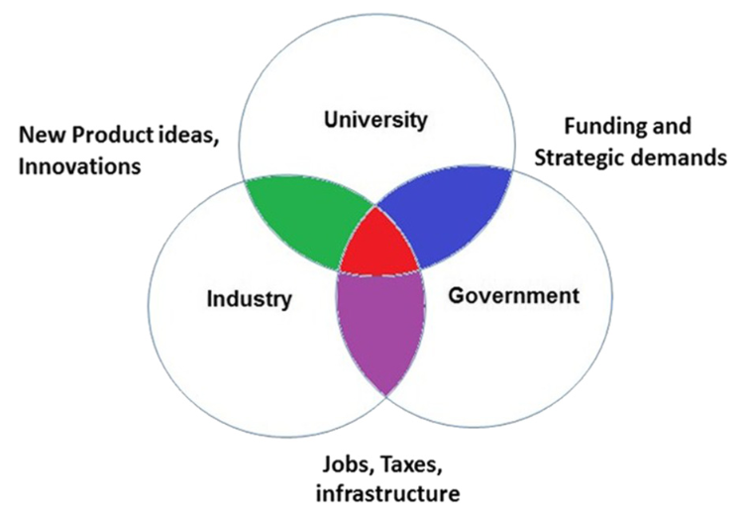
A bit of (well-known) history
Crick, F. H. C., & Watson, J. D. (1953). Molecular structure of deoxypentose nucleic acids. Nature, 171, 738-740.
the double helix
Etzkowitz, H. and L. Leydesdorff (2000). "The dynamics of innovation: from National Systems and “Mode 2” to a Triple Helix of university–industry–government relations." Research Policy 29(2): 109-123.
the triple helix

Slide 6
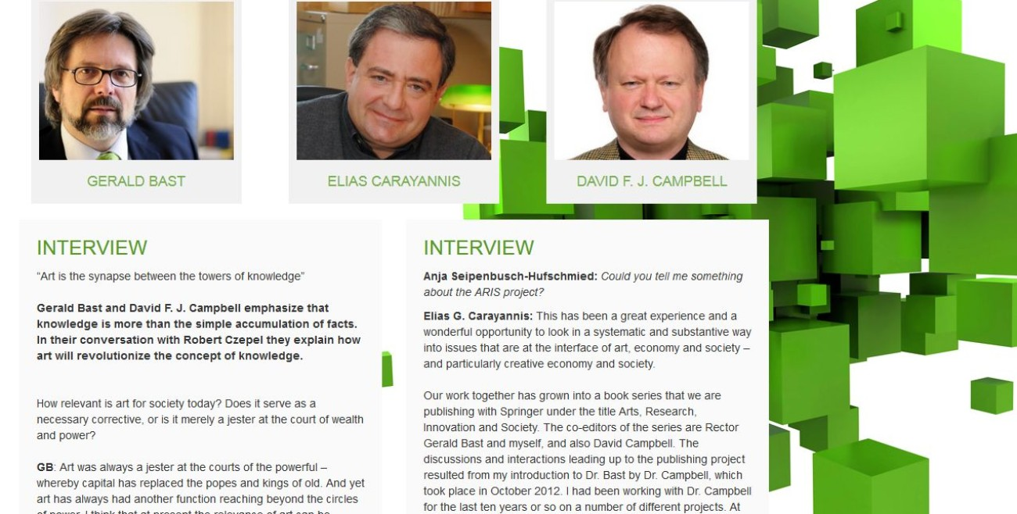
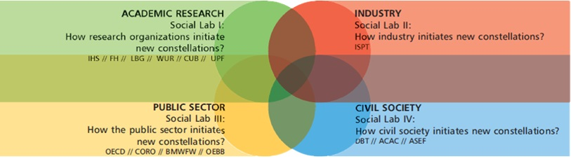
History of QHC
Carayannis, E. and D. Campbell (2009). "'Mode 3'and'Quadruple Helix': toward a 21st century fractal innovation ecosystem." International journal of technology management 46(3/4): 201-234.
the quadruple helix
Jackpot!

Slide 7
3. Why QHC?
Two types of reasons
Normative/moral reasons:
QHC is a more inclusive form of innovation (“democratization”)
QHC is more sensitive to a diversity of innovation risks
QHC directs funding towards sustainability
Pragmatic/strategic reasons:
QHC employs more knowledge resources
QHC is more resilient (no unexpected resistance)
Disadvantages?
Less innovative (more constraints)
More expensive
Form vs. content

Slide 8
RiConfigure Aims
1. Investigate QHC in real life
→ barriers and opportunities for success
2. Analyze the relationship between QHC and responsibility
→ is the QHC a way of doing RRI?
3. Analyze the relationship between QHC and governance structures
→ what can governance structures do to enhance successful QHCs?

Slide 9
Agenda for today
The concept of QHC
The QHC praxis
Lessons learned
Outstanding questions

Slide 10
RiConfigure Cases
5 main cases:
Smart Factory OWL (Germany)
Open Innovation within Austrian Railways (Austria)
GIGAWATT (The Netherlands)
Climatorium (Denmark)
Ideas for Change (Colombia)
49 mirror cases (active participation, included in the analysis)
100+ reference cases (no participation, included in the analysis)

Slide 11
1. The concept and the reality
Concept (QH) implies a theoretical focus stakeholder types
Each stakeholder/system is defined roughly based on the type of knowledge and/or interests it brings to the table
→ knowledge economy
The problem with these types is that they are extremely difficult to operationalize in doing research
Early on, we faced the problem that QHC was either everywhere or nowhere at all!

Slide 12

Example
“Research” Helix
‘Where’ is academia? What is an ‘academic’?
What is it for a piece of research to be placed somewhere?
R&D teams outside universities?
With academic interest? → great, but what is ‘academic interest’?
suddenly important for case selection & interventions!

Slide 13
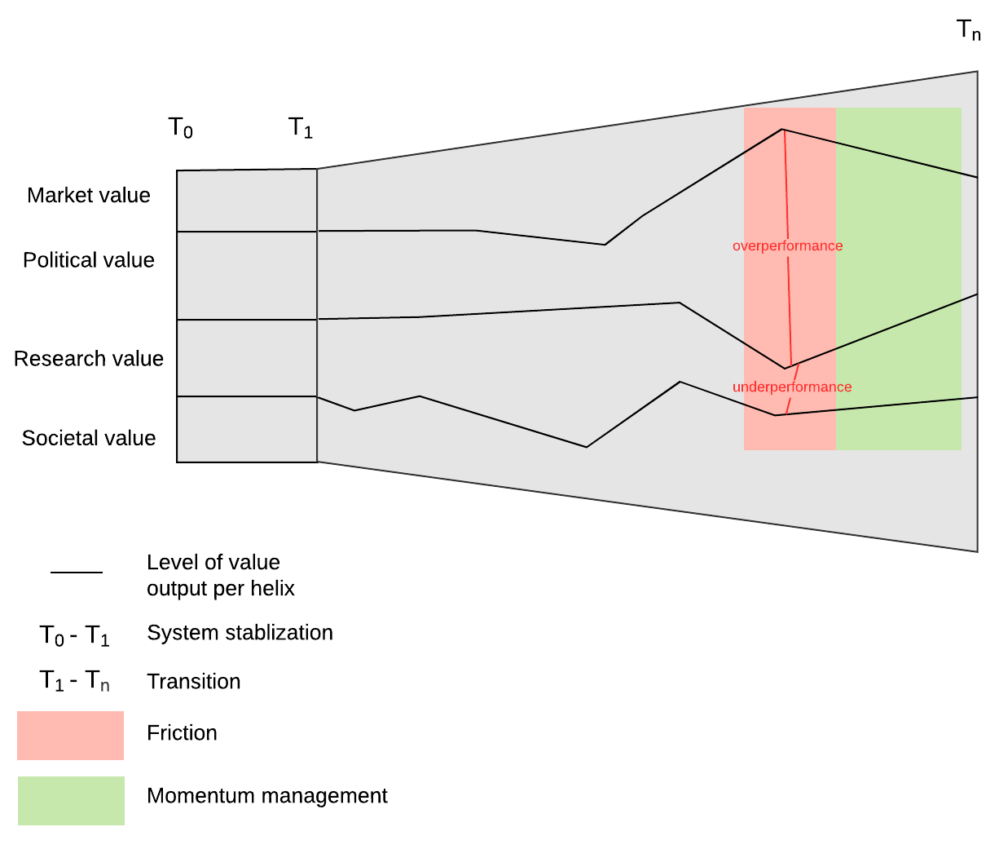
QHC as a process?
(Goal-directed) Behavior, not identities!
(Value) output, not (Knowledge) input
Popa, E. O., Blok, V., Wesselink, R. (2020). "A processual approach to friction in quadruple helix collaborations." Science and Public Policy 47(6): 876-889.

Slide 14
Agenda for today
The concept of QHC
The QHC praxis
Lessons learned
Outstanding questions

Slide 15


3. Lessons learned
Full story?
In chat →
RiConfigure Booklet
Report “Quadruple Helix Collaborations in Practice”
A brief selection →

Slide 16
3. Lessons learned
Power inequalities are natural
Few funding mechanisms actually encourage QHCs (and some indirectly discourage it)
Let a well-known and trustworthy player establish and manage the QHC
Let civil society be represented by professionals!
Formalize/codify what you can (but take it with a grain of salt)
“Make a salad, not a cake!” (value alignment is not a sine qua non)
The importance of regional ties and good ol’ fashion networking
see our reports for more!

Slide 17
Agenda for today
Review the concept of QHC
The QHC praxis as we encountered it
Lessons learned
Outstanding questions

Slide 18

4. Outstanding question #1
What is a ‘QHC-friendly’ R&D policy?
Some ideas, see our policy briefs
http://riconfigure.eu/policy-briefs/
What is the ‘sweet spot’ between forcing unproductive QHCs and missing chances for productive QHCs?
At what level must states seek to foster QHCs? (EU, national, regional?)

Slide 19

4. Outstanding question #2
Innovation → Co-innovation?
(Co-creation, Co-innovation, Co-laboratory etc.)
Clearly: ‘not anything goes’
What are the conditions?
In practice:
Value pluralism (not one value but many)
Some form of ‘justice as fairness’ (not one authority but many)
Agonism (constant competition, not everyone can win)

Slide 20
Thank you! Questions?
dr. Eugen Octav Popa
Post-doc Researcher Responsible Innovation
Wageningen University and Research
eugen.popa@wur.nl

