Slide 1
Results and Lessons on Social Labs
Vienna, June 2021.

Slide 2

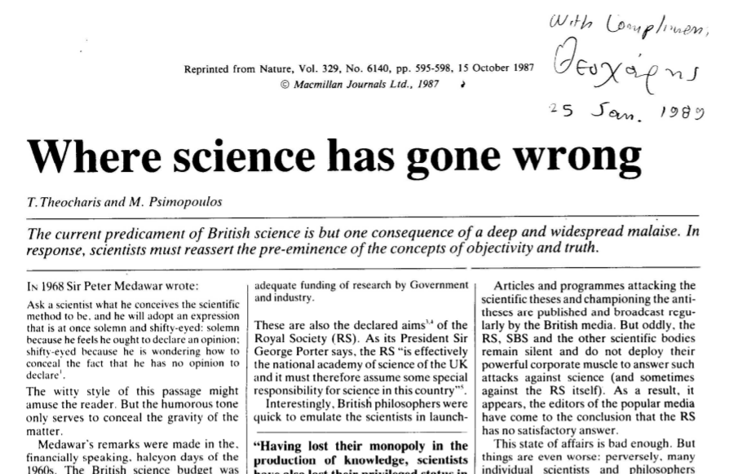
Nature on Science having gone wrong (Nature 329, 6140, 15 Oct. 1987)
Feyerabend as the „the worst enemy of science“
„The antitheses pose at least three different kinds of potential threats or actual dangers not only to science as such but also to society in general. In summary these risks are: (i) intellectual bankruptcy entails finantial bankruptcy; (ii) Epistemological anarchism entails social anarchism; (iii) Epistemological relativism (…) entail scientific chaos, confusion and stagnation.“ (p. 597)
…the solution of the problem is that … practicioners of these disciplines stop running down their own professions and start pleading the cause of science and philosophy correctly. This should be best done, first by thoroughly refuting erroneous and harmful antitheses; secondl by putting forthadequate definitions of such fundamental concepts as objectivity, truth, rationality and the scientific method; and thirdly by putting the latter judiciously into fruitful practice.“ (p. 598)

Slide 3

Feyerabend on „Science in a Free society“
„There is no reason why the research programme science should not be subsumed under the research programme free society and competences changed and redefined accordingly. The change is needed - the possibilities of freedom will not be exhausted without it - there is nothing inherent in science (except the wish of scientists to do their own thing at other people’s expense) that forbids it; which lives off society and strengthens its totalitarian tendencies.” (p. 101)
„The lesson to be learned is that non-scientific ideologies, practices, theories, traditions can become powerful rivals and can reveal major shortcomings of science if only they are given a fair chance to compete. It is the task of the institutions of a free society to give them such a fair chance. The excellence of science, however, can be asserted only after numerous comparisons with alternative points of view.“ (p. 103)

Slide 4
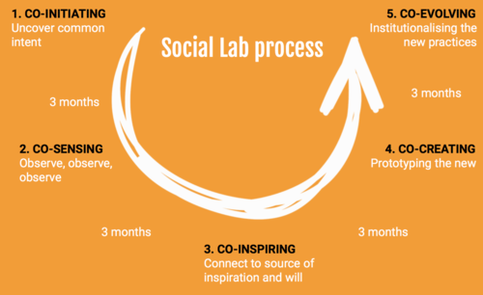
„Non-scientific“ methods -- participatory and democratic
Addressing „wicked problems“ (Rittel and Webber, 1973)
intractable societal challenges that cannot be solved by applying a classic linear techno-scientific approach, as
concomitant uncertainty cannot be reduced with producing more disciplinary knowledge
different actors are often involved with such complex challenges
every possible solution changes the perception of the problem and there is no agreement on values, facts and relevancy of facts.
Producing knowledge through participation:
flow experiential knowledge and enabling actors in a system to produce, appreciate, and select productive intervention strategies and arrive at the coordination of problem solving and decision making.
Applying action research:
A process concerned with developing practical knowing in the pursuit of worthwhile human purposes. It seeks to bring together action and reflection, theory and practice, in participation with others, in the pursuit of practical solutions to issues of pressing concern to people, and more generally the flourishing of individual persons and their communities.

Slide 5
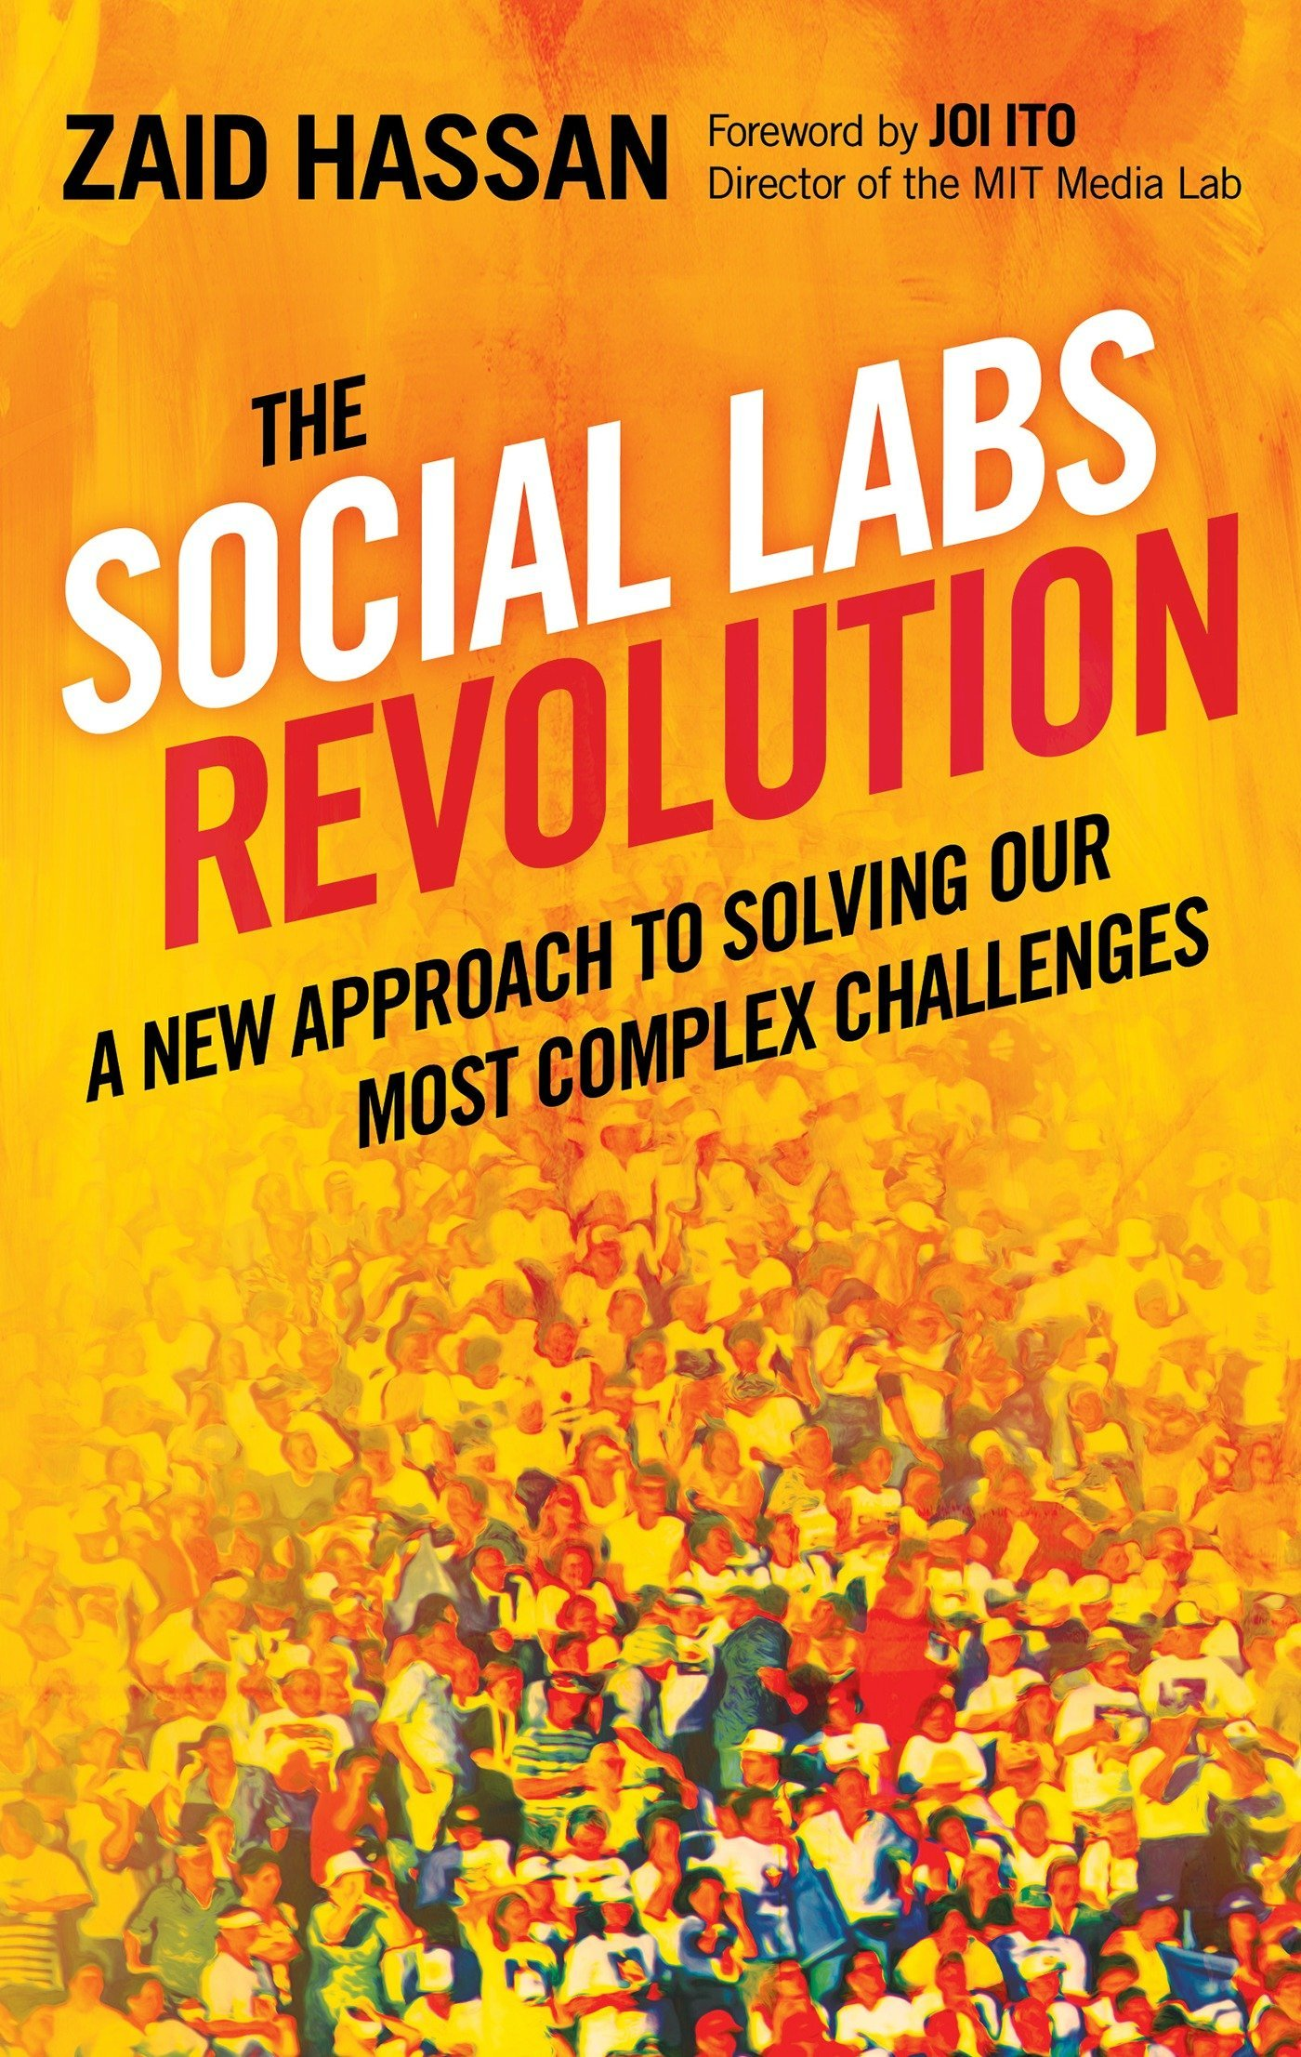
Social labs as a participatory and democratic method
Social Labs provide research settings for doing social experiments in the context of particular societal challenges where experts and stakeholders collectively work together to initiate actions focused on addressing these challenges. It is not guided by predetermined project plans, lists of deliverables and without knowing how to proceed (Hassan 2014) but instead, to proactively experiment with possible strategies, approaches and solutions at the micro level in order to draw lessons for the systemic level of research practices.
Social Labs
Offer a space for experimentation with actions to address societal challenges.
Involve social experiments in real-life settings.
Various types of stakeholders participate actively in addressing the societal challenge.
Inter- and multi- disciplinary (e.g. non traditional) involving a wide range of expertise and backgrounds.
Experimentation with action on the micro level supports solutions and prototypes on a systemic level and aims to achieve systemic change.
Iterative, agile approach and involve learning cycles, allowing the evolution of prototypes and solutions over time.
(Timmermans et al 2020)

Slide 6
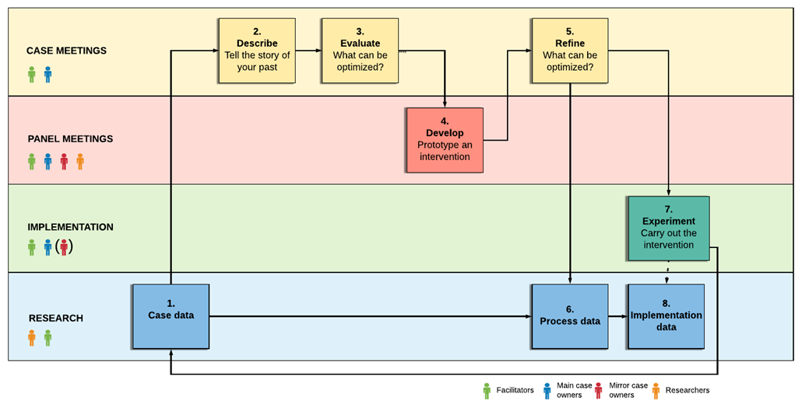
What did we do in the social Labs
Invite stakeholders & setup SL as
democratic and participatory process
Analyse „cases“ and create input via
traditional methods
Define/describe a social challenge for the SL
(based on input and praxis)
Define/describe barriers and obstacles
Create interventions/prototypes of (social) innovation
Experiment in real life
Reflect/refine/redo
Experiment in real life
Reflect and draw conclusions

Slide 7
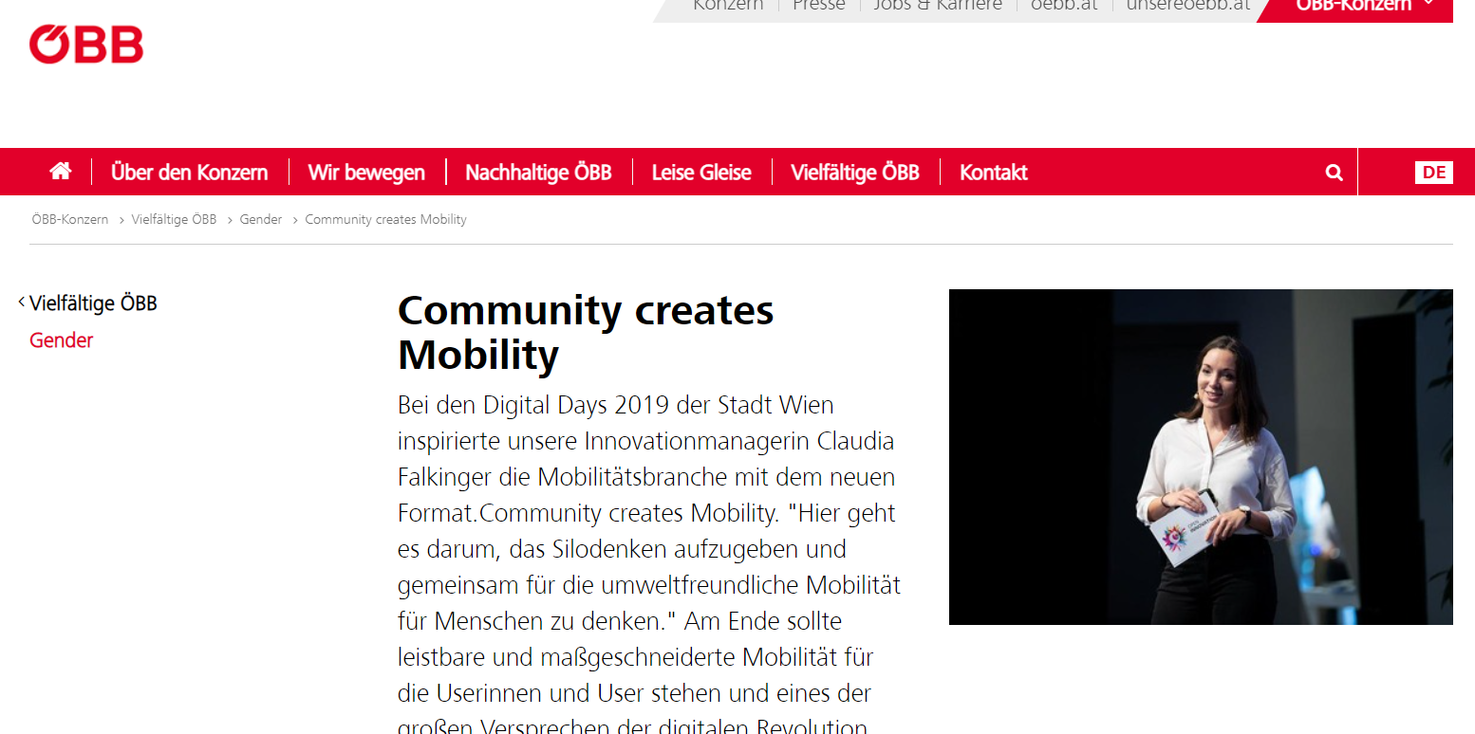
FindiNgs about Social labs
Social Labs offered a safe space for experimentation.
Example: Shift from a “real estate project” to a “community building” project
Interventions resulted in very specific and tangible outputs that were implemented in real-life.
Example: Commoning as a way of reconfiguring mobility – setting up the community and creating “learning journeys”
Interventions were the product of collaborative work of stakeholders with various backgrounds who actively and jointly developed the pilot actions.
Example: members of the community decided who to invite, what form of action they would like to follow, what is the core innovation they are interested in and whom to learn from.
All 4 Social Labs were diverse in terms of their members, even though some stakeholder representatives were more difficult to attract.
Example: While a great variety of stakeholders were involved, CSO members were hard to engage and sustain
Interventions were designed as action to be integrated into the daily activities of Social Lab members, resulting in ripple effects in the home institution of the Social Lab members and instances of institutional change could be noted.
Example: ÖBB has changed its ambition, form of control and mode of operation re: OI during the process

Slide 8
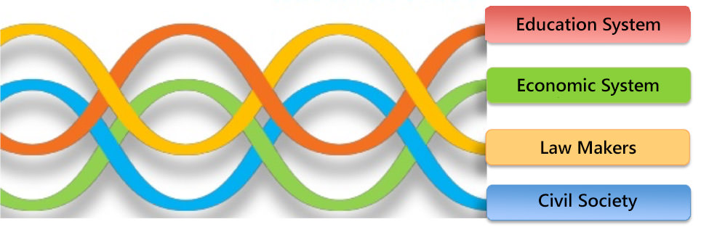
FindiNgs about QH via Social Labs
Social Labs offered a safe space for experimentation.
Example: “Once the SL interventions started, we noticed that this tightly woven community is not at all closed. They are particularly interested in discussing with us and among themselves about the socio-ethical challenges of the hydrogen economy. Furthermore, they are generally very knowledgeable and opinionated on such issues, so it is not at all difficult to persuade them to speak up.“
Interventions resulted in very specific and tangible outputs that were implemented in real-life.
Example: “The idea was to co-create a document with guiding ideas and values for mobility. This document was created in two workshops that invited all members of CCM.”
Interventions were the product of collaborative work of stakeholders with various backgrounds who actively and jointly developed the pilot actions.
Example: “Societal actors have a lay perspective on technologies, allowing them to draw attention to needs, overall trends and ethical, environmental and social implications of technologies; this is very important for industry 4.0 as it may grant or deny the acceptance of the technology.”
All 4 Social Labs were diverse in terms of their members, even though some stakeholder representatives were more difficult to attract and sustain.
Example: “civil society was represented by underprivileged communities lacking sufficient financial resources to travel or even electricity and internet access to participate online in project meetings. This implies that often their opinions on collaboration dynamics and project outcome decisions are “interpreted” by the other members of the QH or even ignored entirely.”

Slide 9
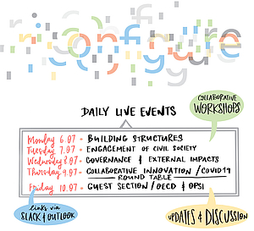
Overall methodology conclusions
Research question re: method: How does the Social Lab methodology support democratic and participatory research?
Openness and stakeholder inclusiveness (also following QH principles) offer alternative (civic/lay) perspectives
Tangible, co-created experiments/interventions offer new (and different) knowledge then that of “observation”
Stakeholder/helix conflicts point to real life situations and offer reflection potential on the politics of knowledge
Collaboration dynamics and drop-outs (or underrepresentation) point to input relevance (as opposed to outcome relevance e.g. missions)

Slide 10


