Slide 1

Institutional Change for Responsible Innovation
Dr.Dr.phil. René von Schomberg
European Commission
Guest-Professor, Technical University Darmstadt, Germany (and sometimes elsewhere)
Establishing national and planetary public goods

Slide 2
The Rationale of Open Science
Open scholarship is defined as (Von Schomberg, 2019, In International Handbook on Responsible Innovation. A Global Resource):
“sharing knowledge and data as early as possible in the research process in open collaboration with all relevant knowledge actors”
Implications: openness to knowledge sources and knowledge actors

Slide 3
Open Research and Scholarship: sharing knowledge/data as early as possible with all knowledge actors (Von Schomberg, 2019)
Scientific discovery and analysis
Open knowledge sources, e.g. open data, open publications, samples, etc.
Open Review and research assessment
Open outputs, publications data, samples, software, etc.
Know-ledge dissemi-nation and outreach
Open research agenda
Knowledge coalitions, public-private partnerships, stakeholder commitments on societal desirable objectives, etc.
Open knowledge producers, e.g. academia, citizen scientists, civil society organisations, open innovators including industry
Open Science is making science more efficient, reliable and
responsive to societal challenges : Why not apply to all SDG’s

Slide 4
Towards a new modus operandi for Science: A necessary, yet insufficient condition for RRI
Current System (dominant)
Rewarding individual competing scientists - gaining scientific prestige
Publish as much and as fast as possible: (publish or perish!)
Excellence as a self-referential criterion
Incentivises researchers to produce specific outputs (mainly publications) | Use of quantitative metrics to ‘measure’ quality and productivity
Open Research and Scholarship
Rewarding collaboration and sharing to achieve societal impact (e.g. Covid-19)
Share knowledge/data as early as possible in open collaboration : collaborate with open research agenda’s or have no social desirable impact!
Relative contribution to research missions with a focus on a societal challenge:
Incentivises researchers to conduct particular research behaviour: share knowledge/data, collaborate, transnational, transdisciplinary, with all knowledge actors | Relative contribution to a research mission-qualitative assessment of research behaviour

Slide 5
Addressing Market-Failure: We are subject of change rather than agent of change
Responsible innovation constitutes a new paradigm for innovation, in which our social systems institutionalizes collective co-responsibility as a driving force for socially desirable innovation, by giving innovation a direction and whenever possible, shaping its characteristics
Addressing Market Failure (and dependence on philanthropists): new conditions for the ‘market’: stakeholder commitment, deployment of non-legislative actions, codes of conduct, certification, new innovation standards, new public-private partnerships, no IPR in RTD discovery phase etc

Slide 6
Reflexivity level | Normative approach to RRI as process | Normative approach to targets and products | Normative approach to governance
Theory of RRI | Collective co responsibility | Public goods | Anticipatory governance
Implementation in research | Co creation and design of research agenda | Open, collaborative research, mission oriented research | Employment of foresight, public governance of research, rewards and incentives for researchers
Implementation in innovation | Co creation design socialy desirable innovation objectives | Open, value driven innovation, value sensitive design, public private partnerships, innovation management | Public governance of economy, transition management to sustainability

Slide 7
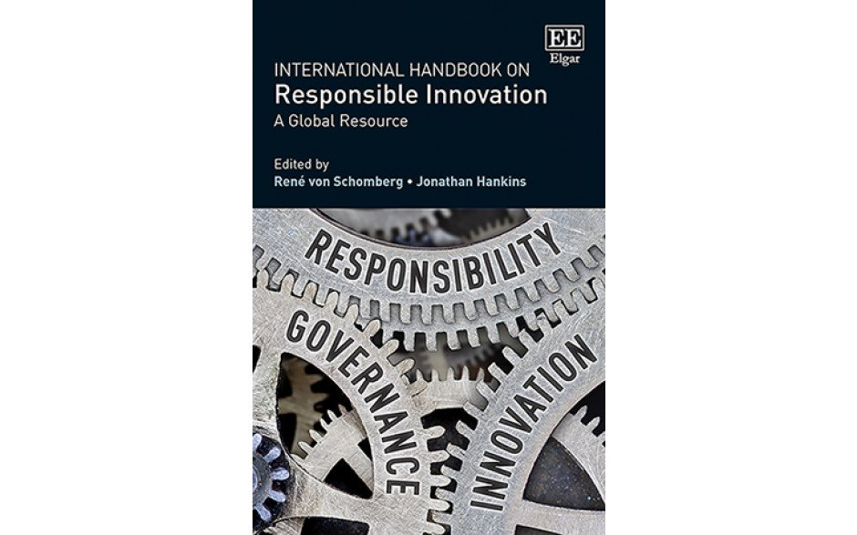
International Handbook on Responsible Innovation
A Global Resource
Edited by René von Schomberg, Directorate General for Research and
Innovation, European Commission, Belgium and Guest Professor ,Technical
University Darmstadt, Germany and Jonathan Hankins, The Bassetti
Foundation, Italy
The Handbook constitutes a global resource for the fast growing
interdisciplinary research and policy communities addressing the challenge of
driving innovation towards socially desirable outcomes. This book brings
together well-known authors from the US, Europe and Asia who develop
conceptual and regional perspectives on responsible innovation as well as
exploring the prospects for further implementation of responsible innovation in
emerging technological practices ranging from agriculture and medicine, to nanotechnology and robotics.
The emphasis is on the socio-economic and normative dimensions of innovation including issues of social
risk and sustainability.
‘After 75 years of unprecedentedly
The International Handbook of Responsible Innovation is thus a guidebook for a shift in stance toward collective accountability for the products and consequences of our own ingenuity.’
– Daniel Sarewitz, Arizona State University, US

Slide 8

renevonschomberg.wordpress.com
On Responsible Innovation, open science and ethics: please send me your comments!
Thanks for your attention

